Slide 1

Predicting Industry Health
for Consulting
Firm Sales
John Nguyen
Apprenticeship Capstone Project
Deloitte AI Academy ™

Slide 2
Agenda
1
5
Problem
Predictions
2
6
Project Context
Conclusion
3
7
Data Understanding
Recommandation
4
8
Modeling
Q&A
Notes:
JOHN

Slide 3
Problem
Takeaway:
“58% of economists envision a recession this year”
- National Association for Business Economics Survey
We are entering a Volatile Market…
Consulting firms must adjust the way they approach their sales efforts.
Notes:
JOHN

Slide 4
Project Overview
1
Objective
3
Overview
Identify “Industry Health” to answer:
As it is harder to sell in volatile markets, how should we change our sales approach ?
What industry should we focus efforts on to maximize sales?
Use past industry performance
(2021 & 2022 Fortune 100 Company Data)
to predict future profit margin.
Digital maturity (1 to 10 scale)
2
Defining “Health”
Compare industry health to predict which market has the most
“opportunity” for consulting projects.
PROFIT MARGIN = HEALTH
Net profit margin is one of the most important indicators of a company's financial health.
The “healthier” the industry, the more opportunity there are for project sales.
Notes:
Tags: data visualization, bubble chart

Slide 5
Data Understanding
How Consulting Firms Sell:
Machine Learning to Predict Industry Health
Firms are organizationally split by different industries, services, & offerings
Consulting firms sell technology implementation & management consulting projects
We will be comparing the Tech Industry Health to Non-Tech Industry Health
Pull Fortune 1,000 Company Data in 2021 & 2022
Minimize the data set from 1,000 to 100
Classify each company by Industry “Tech or Not”
2021
Fortune 100 Company Data
2022
Fortune 100 Company Data
Variables from the “Fortune 100” Dataset
Independent: Revenue, Expenses | Dependent: Profit

Slide 6
Modeling
Linear Regression
Predict 2023
Profit Margins
Scatterplot
Linear regression analysis is used to predict the value of a variable based on the relationship between input and output.
The linear regression model could be used to predict the either the rise or fall of profits in relation to revenue and expenses.
We utilized linear regression because we’re working with 1 or more variables to predict an outcome.
This model could be used for years beyond 2023 if you consider a similar economic environment.
Scatterplots will show the outputs of profits against revenues & expenses.
The slope ratio shows the cumulative mean of all companies in an industry.
The slope or rate of change for the regression helps us predict what industry has the ”opportunity cost ratio”

Slide 7
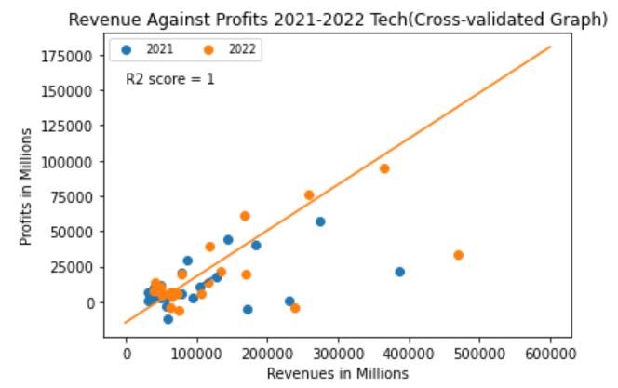
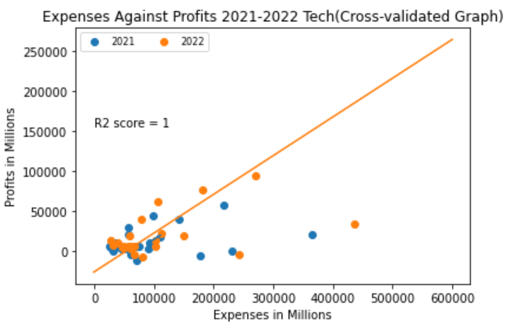
Tech Industry Prediction
Analysis:
Wide distribution of revenue/expense against profit = varying and potentially unpredictable market for stable profit margins.
When looking at total market value there is “OK” potential value.
The R^2 score referenced in the graph shows the coefficient of determination which is a statistical way of measuring how well a model can predict. It is rated out of 1 so the closer it is to predicting the model the higher the determination score.
Takeaway:
The slope or rate of change for the line of regression is 0.48 which means you get 48% return on investment.
The determination score is 1.

Slide 8
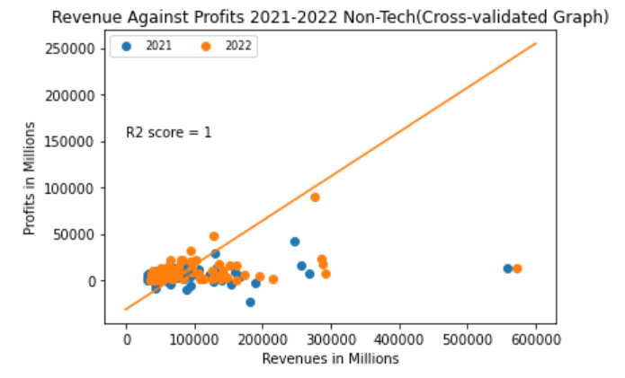
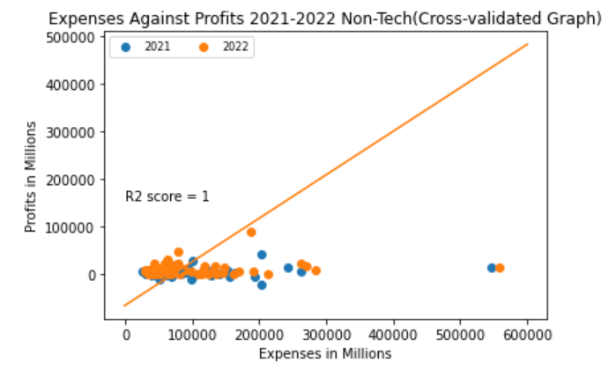
Non-Tech Industry Prediction
Analysis:
High precision & accuracy in the distribution of revenue/expense against profit = predictable market for stable profit margins.
When looking at total market value there is high potential value.
Takeaway:
The slope or rate of change for the line of regression is 0.91 which means you get 91% return on investment.
The determination score is 1.

Slide 9
Conclusion
The opportunity cost ratio is better
It’s better to sell in a predictable market instead of a volatile market
Maximize your sales pursuit efforts
Focus sales activities on the Non-Tech Market.
Next Steps
Continue to watch the marketplace
Identify Key Accounts
Create a 2023 Sales Strategy
Run more tests with a bigger data set and consider other variables such as: Operating Cost, Cost of Goods, EBIDTA.
Further breakdown into industries such as manufacturing & advertisement and Identify key players to sell.
Get leadership and management aligned and revamp current sales efforts to win more deals.

Slide 10



Thank You !
John Nguyen
Analyst @ Deloitte Consulting LLP
AI Strategic Growth Offering | Human Capital – HRT: OT
Q&A
+ Feedback
Notes:
HENRY

Slide 11
Citations
https://news.crunchbase.com/startups/tech-layoffs/
https://apnews.com/article/inflation-united-states-government-recessions-and-depressions-economy-business-c14699b792454e4d2d3d642d65ff4395#:~:text=WASHINGTON%20(AP)%20%E2%80%94%20A%20majority,despite%20steadily%20higher%20interest%20rates.
What is Net Profit Margin? Formula for Calculation and Examples (investopedia.com)

